Slide 1


Mastermind Game

Slide 2
Given the present generation’s acquaintance with gaming and its highly demanded technology, many aspire to pursue the idea of developing and advancing it further. Eventually, everyone starts at the beginning. Mastermind is an old code-breaking game played by two players. The game goes back to the 19th century and can be played with paper and pencil.

Slide 3
RULES OF THE GAME :
Two players play the game against each other; let’s assume Player 1 and Player 2.
Player 1 plays first by setting a multi-digit number.
Player 2 now tries his first attempt at guessing the number.
If Player 2 succeeds in his first attempt (despite odds which are highly unlikely)
he wins the game and is crowned Mastermind! If not, then Player 1 hints by
revealing which digits or numbers Player 2 got correct.

Slide 4
The game continues till Player 2 eventually is able to guess the number entirely.
Now, Player 2 gets to set the number and Player 1 plays the part of guessing the number.
If Player 1 is able to guess the number within a lesser number of tries than Player 2 took, then Player 1 wins the game and is crowned Mastermind.
If not, then Player 2 wins the game.
The real game, however, has proved aesthetics since the numbers are represented by color-coded buttons.

Slide 5

FOR EXAMPLE :
Input: Player 1, set the number: 5672 Player 2, guess the number: 1472
Output: Not quite the number. You did get 2 digits correct. X X 7 2 Enter your next choice of numbers:

Slide 6
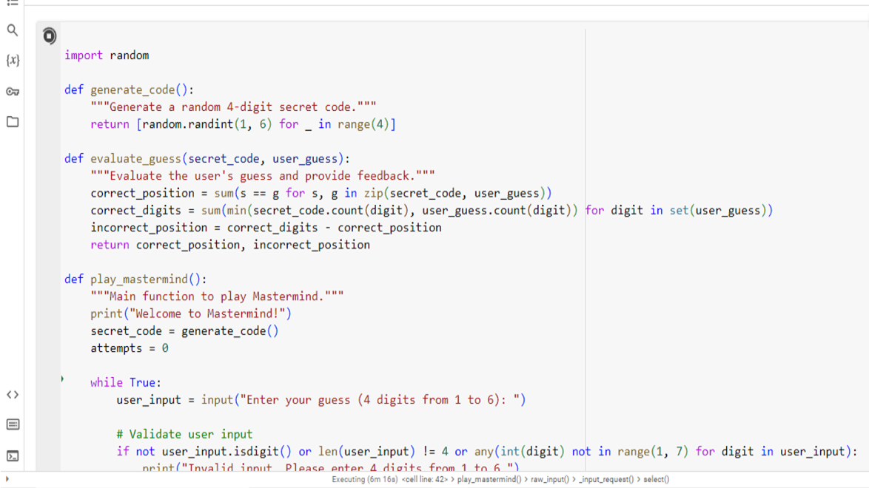
PROGRAM CODING :

Slide 7
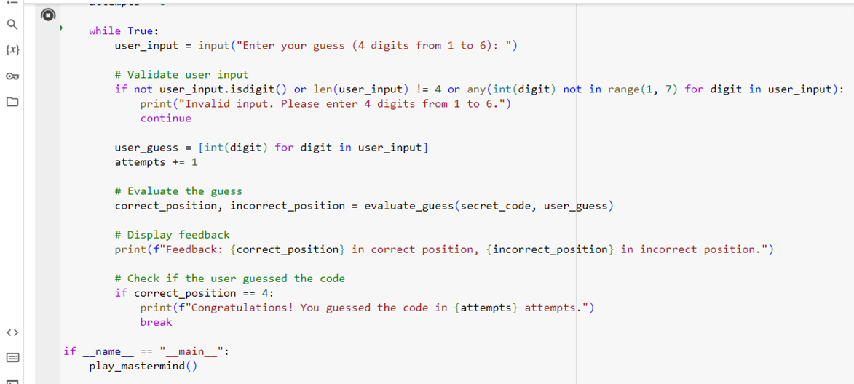

Slide 8
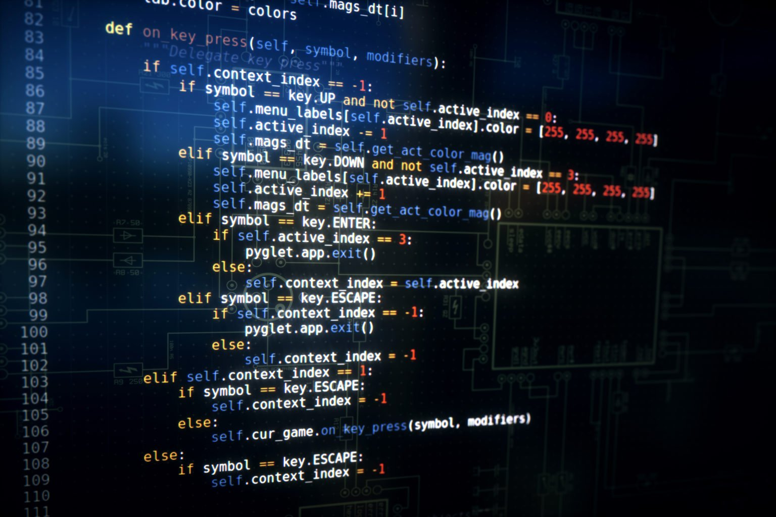
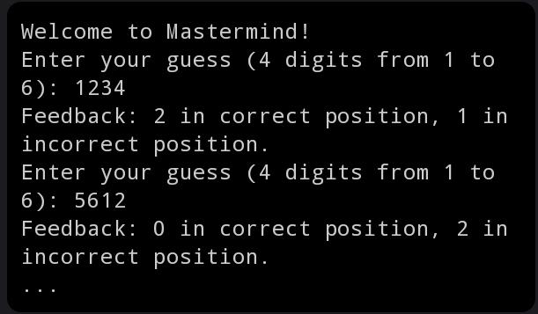
PROGRAM OUTPUT :

Slide 9
Code Generation (generate_code function):
This function generates a random 4-digit secret code using numbers from 1 to 6 (inclusive).
Evaluation (evaluate_guess function):
This function takes the secret code and the user’s guess as input and provides feedback on the guess.It calculates the number of digits in the correct position (correct_position) and the number of digits in incorrect positions (incorrect_position).
Game Loop (play_mastermind function):
The main function to play Mastermind.It starts by generating a secret code and initializing the number of attempts.Inside a while loop, the user is prompted to enter a guess.User input is validated to ensure it consists of 4 digits from 1 to 6.The user’s guess is then evaluated using the evaluate_guess function, and feedback is displayed.The loop continues until the user correctly guesses the code (all digits in the correct position).The number of attempts is displayed upon successful guessing.

Slide 10

Main Block (__main__ block):
Calls the play_mastermind function when the script is executed.
To play the game, users input guesses, receive feedback on the correctness of their guesses, and continue until they guess the correct code. The code includes basic input validation to ensure the user’s input is in the correct format.
Conclusion :
Overall, this code forms a basic Mastermind game where the player interacts by inputting guesses, and the program provides feedback. The game loop continues until the correct code is guessed, and the number of attempts is then displayed.

Slide 11


